Slide 1


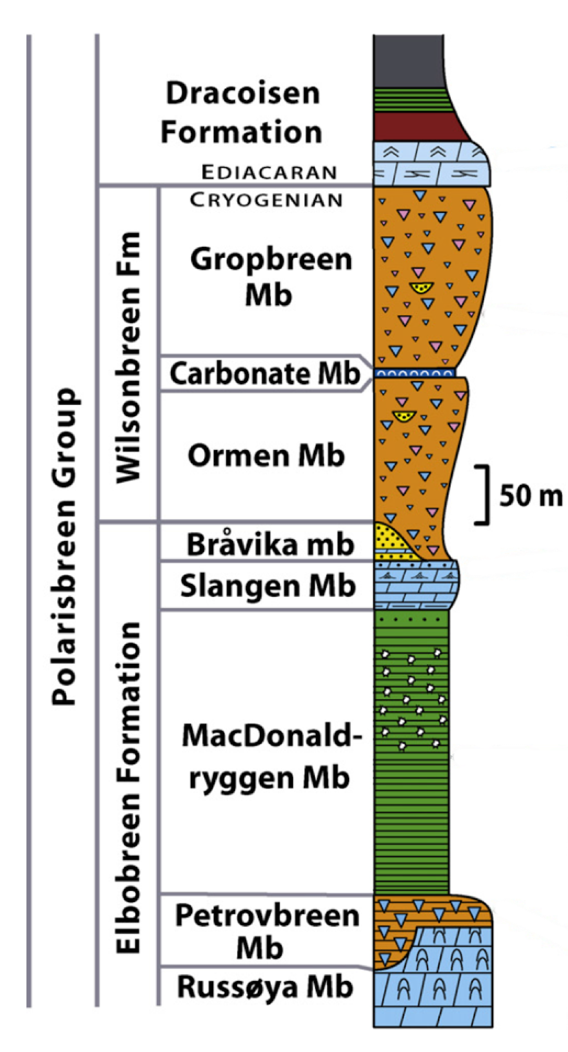
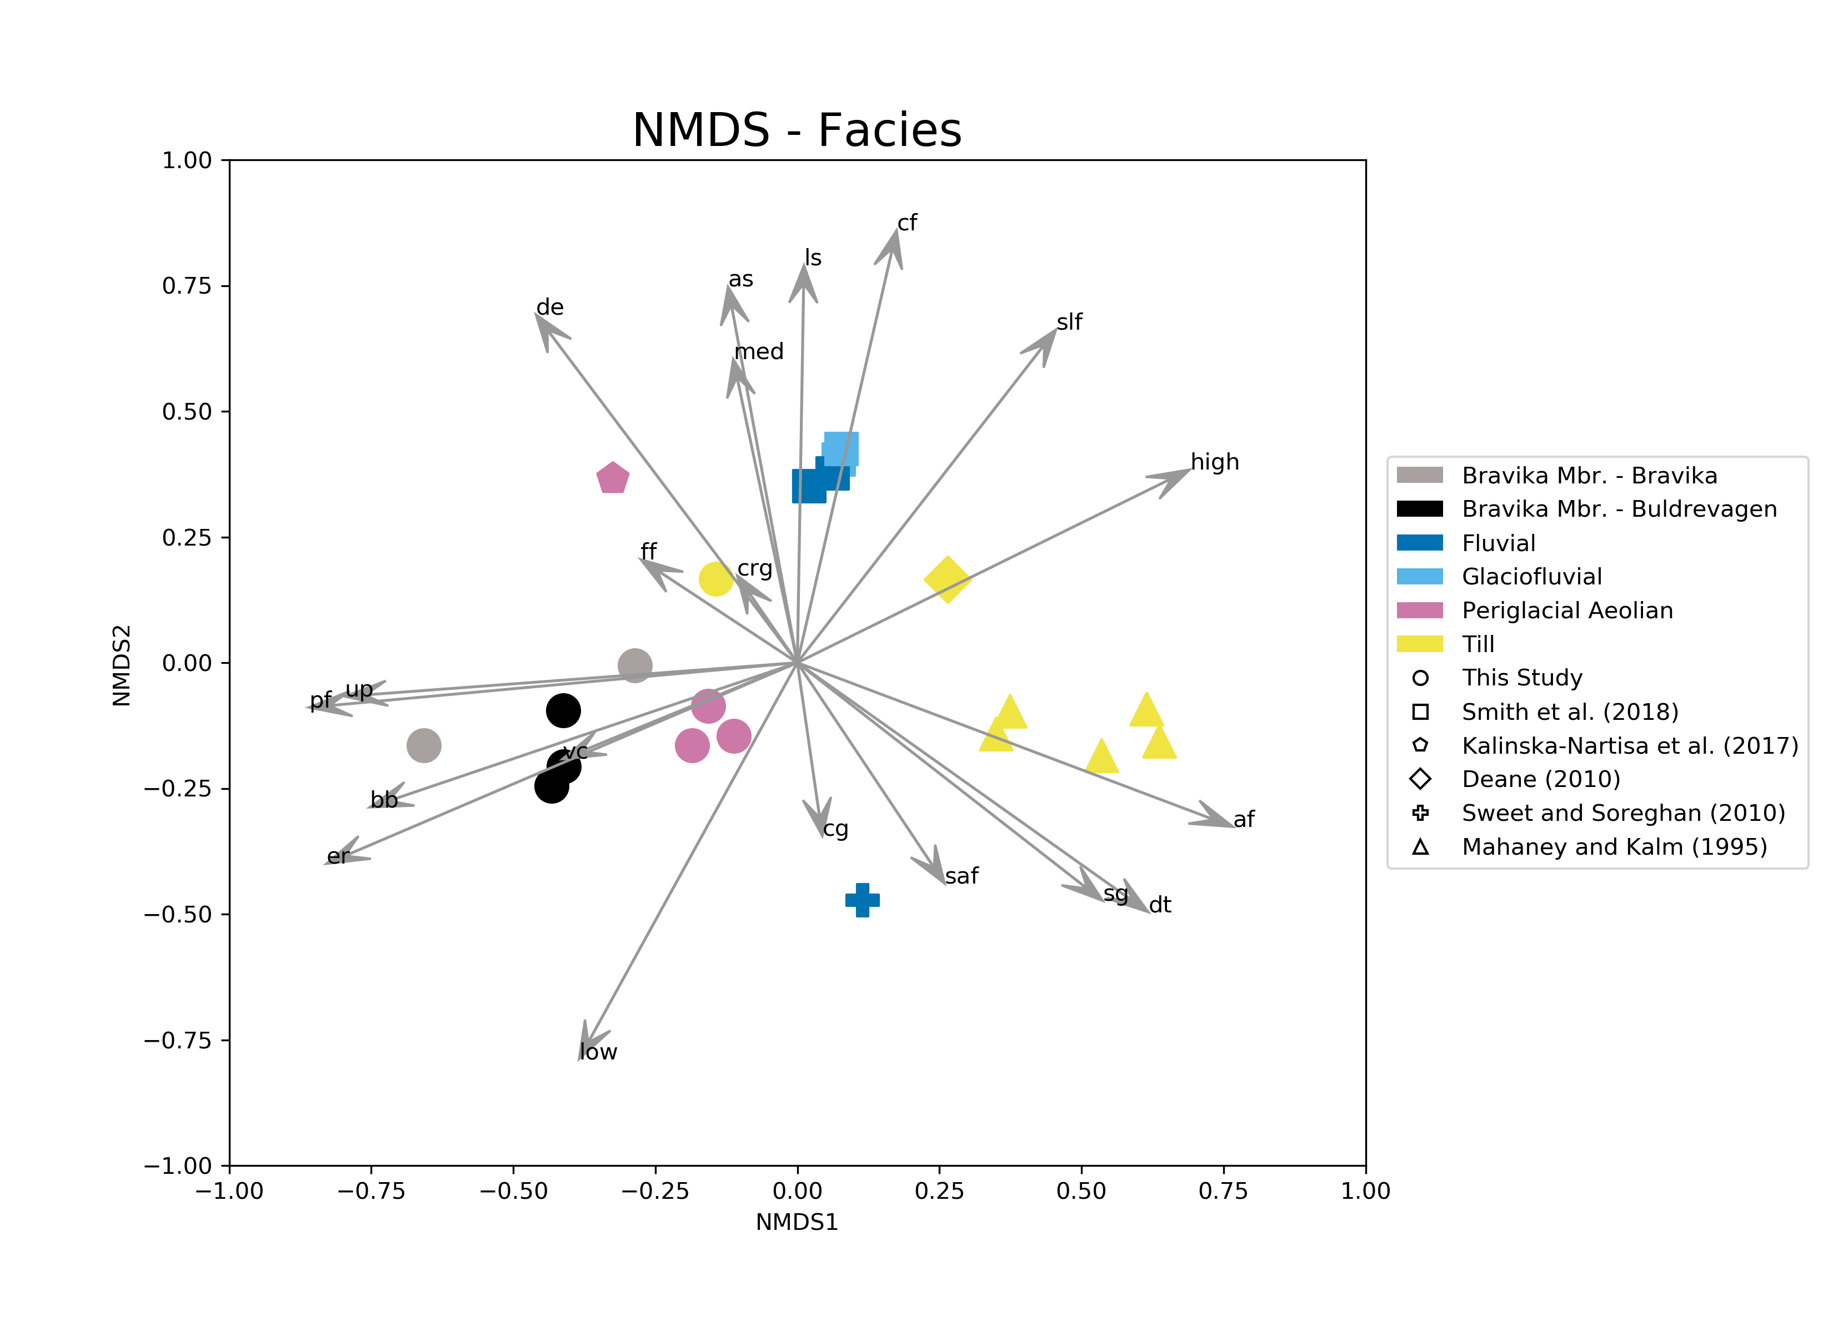
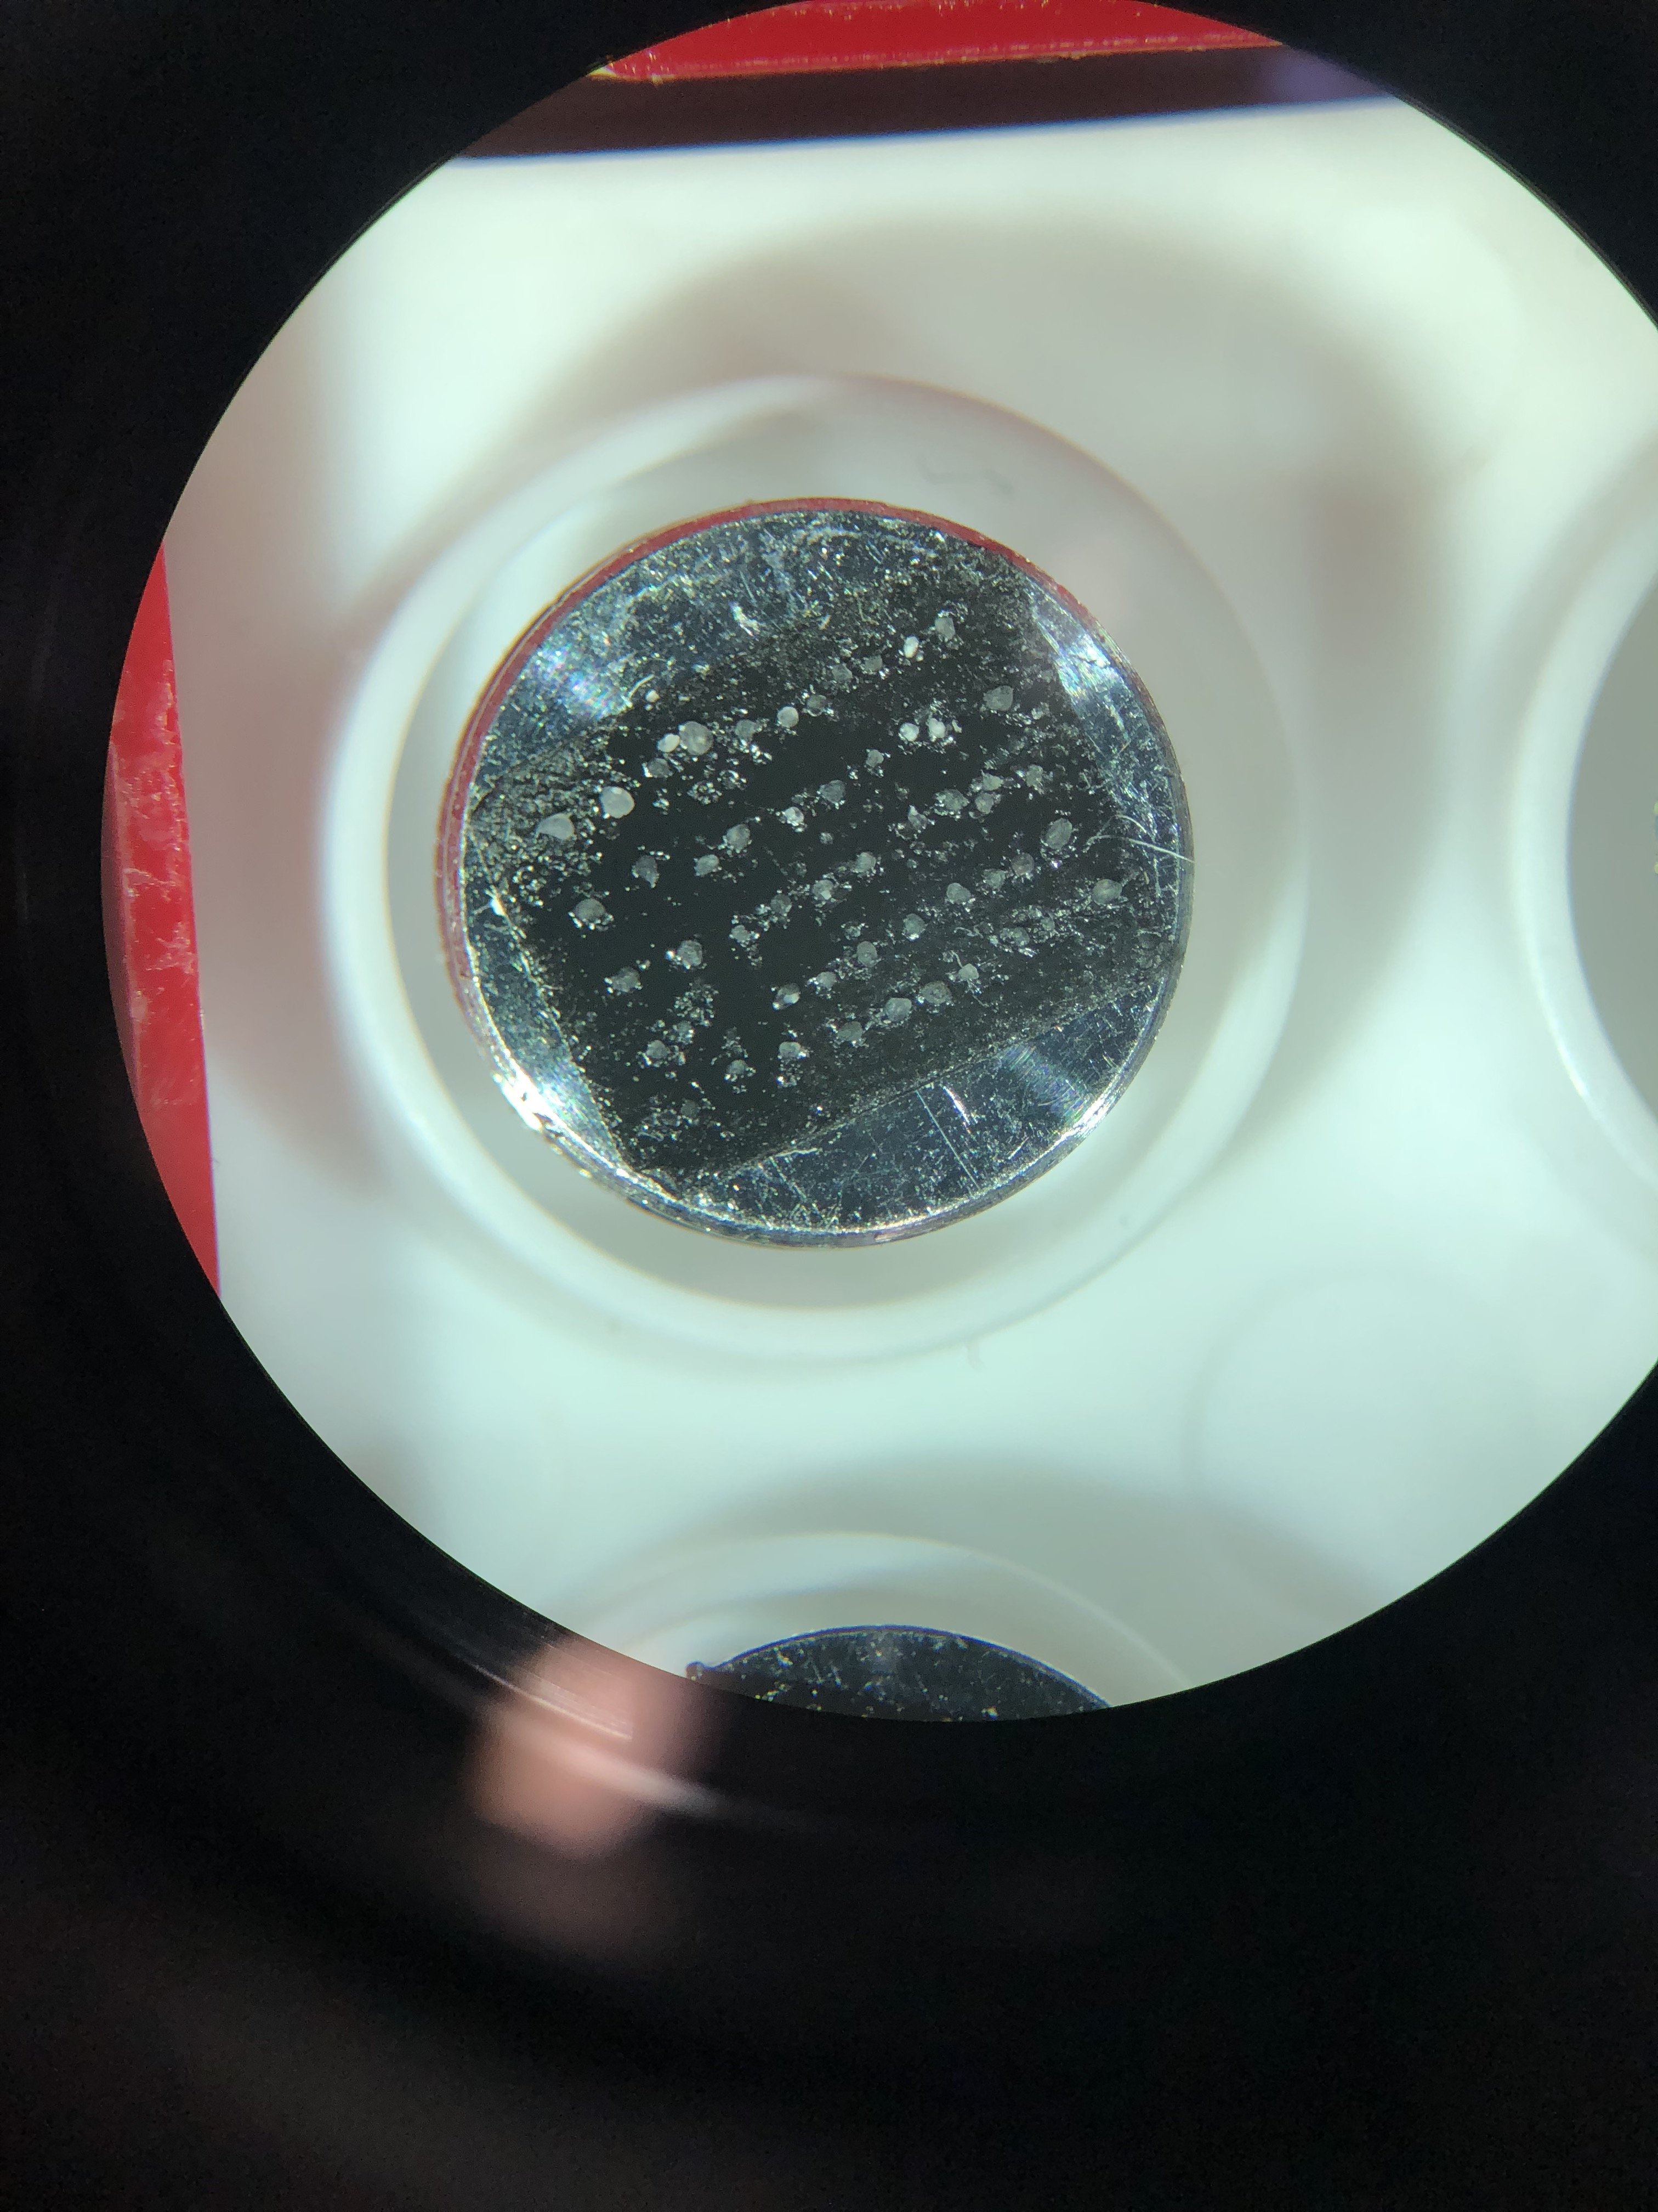
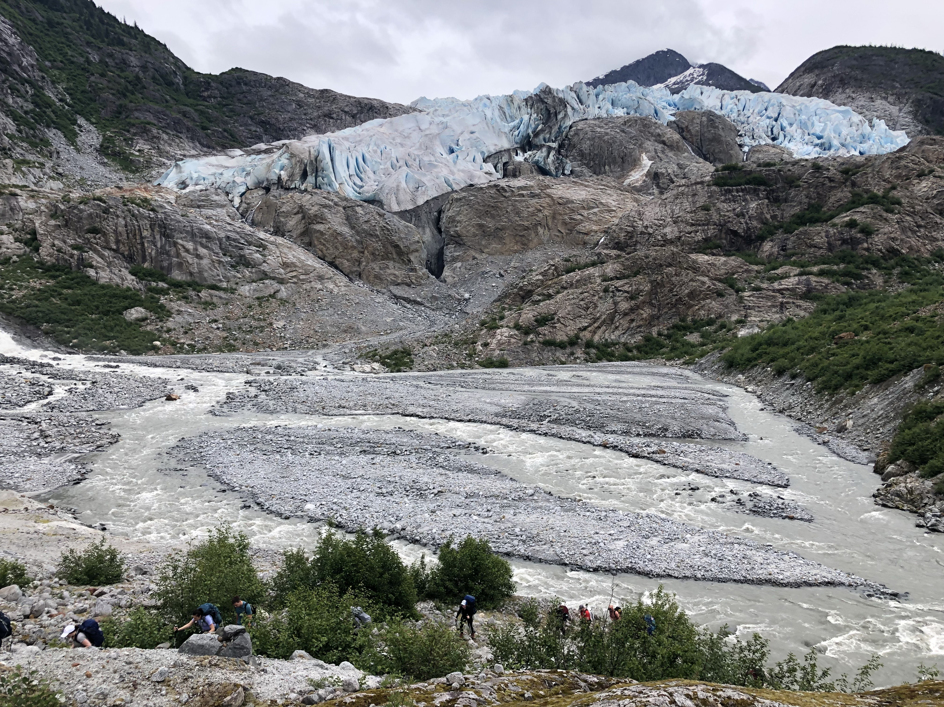
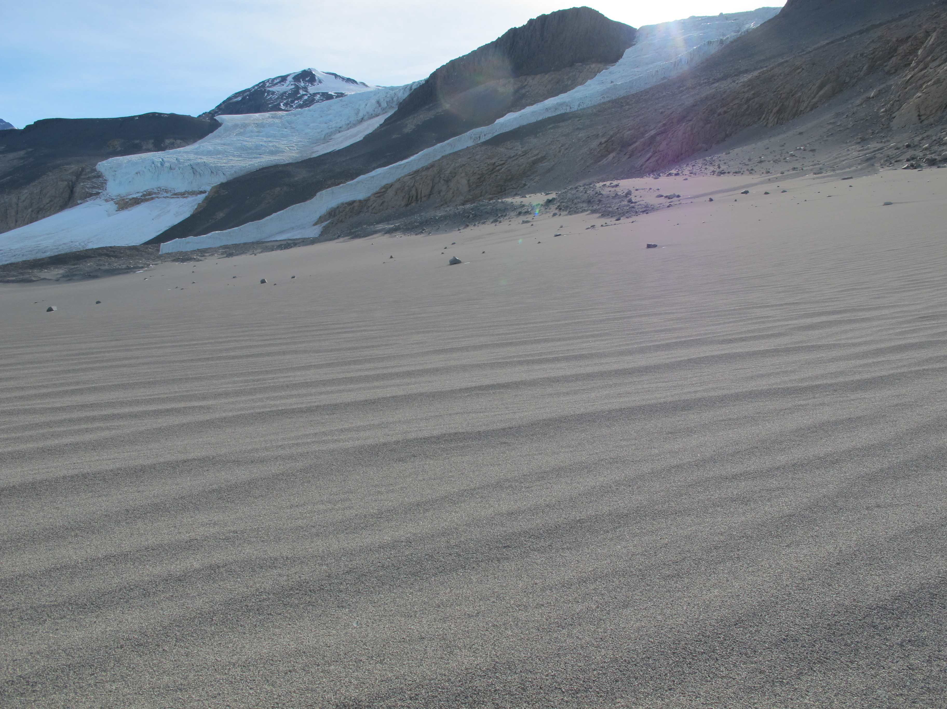
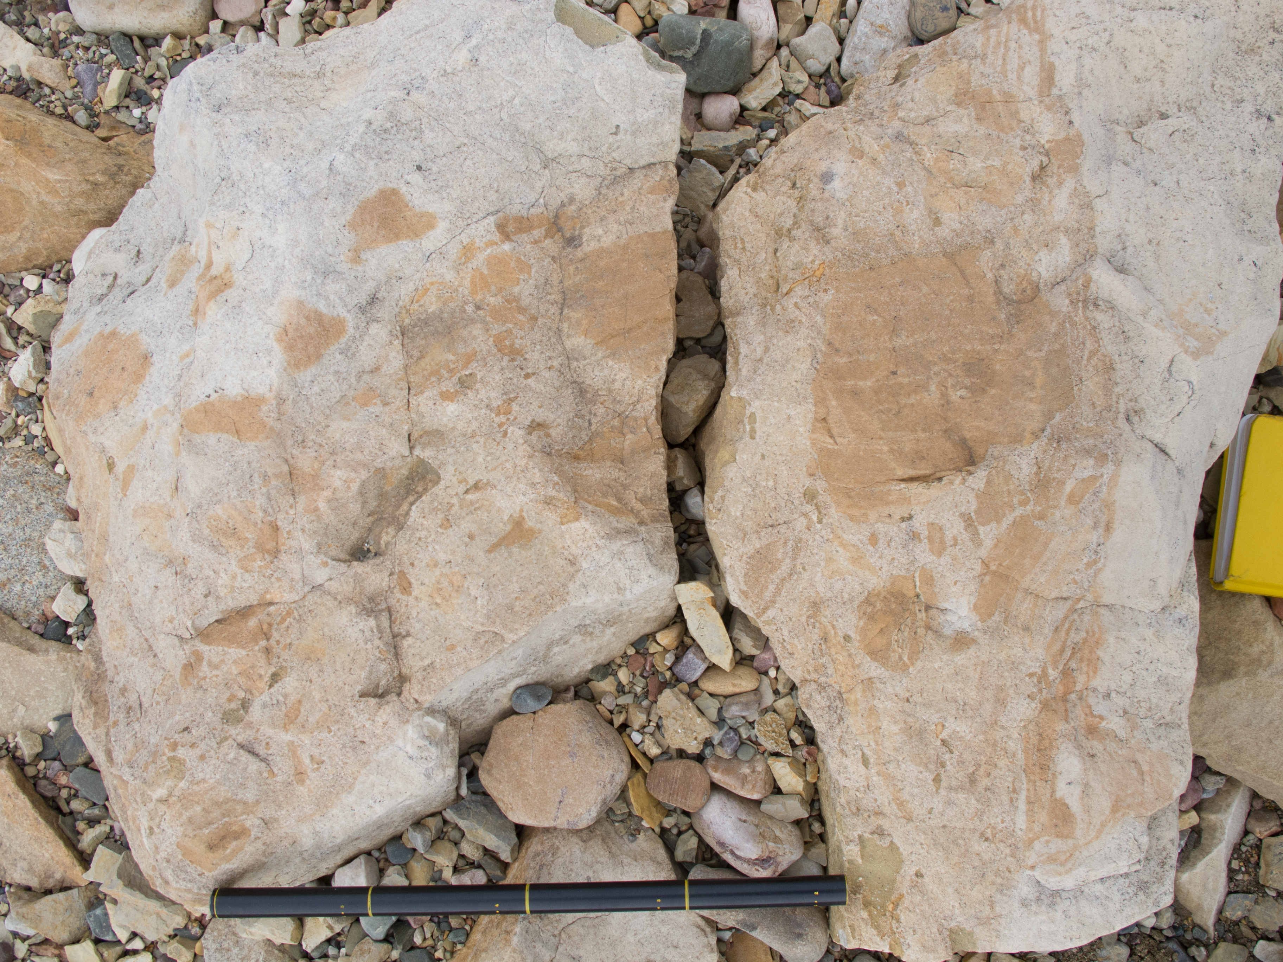
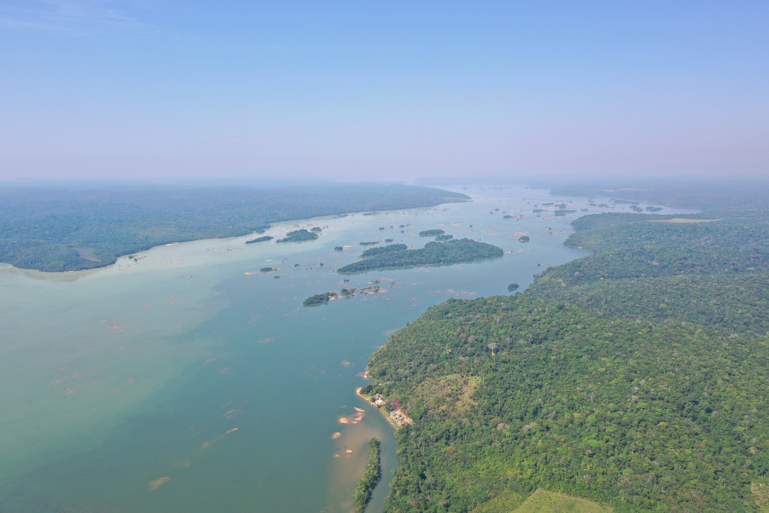
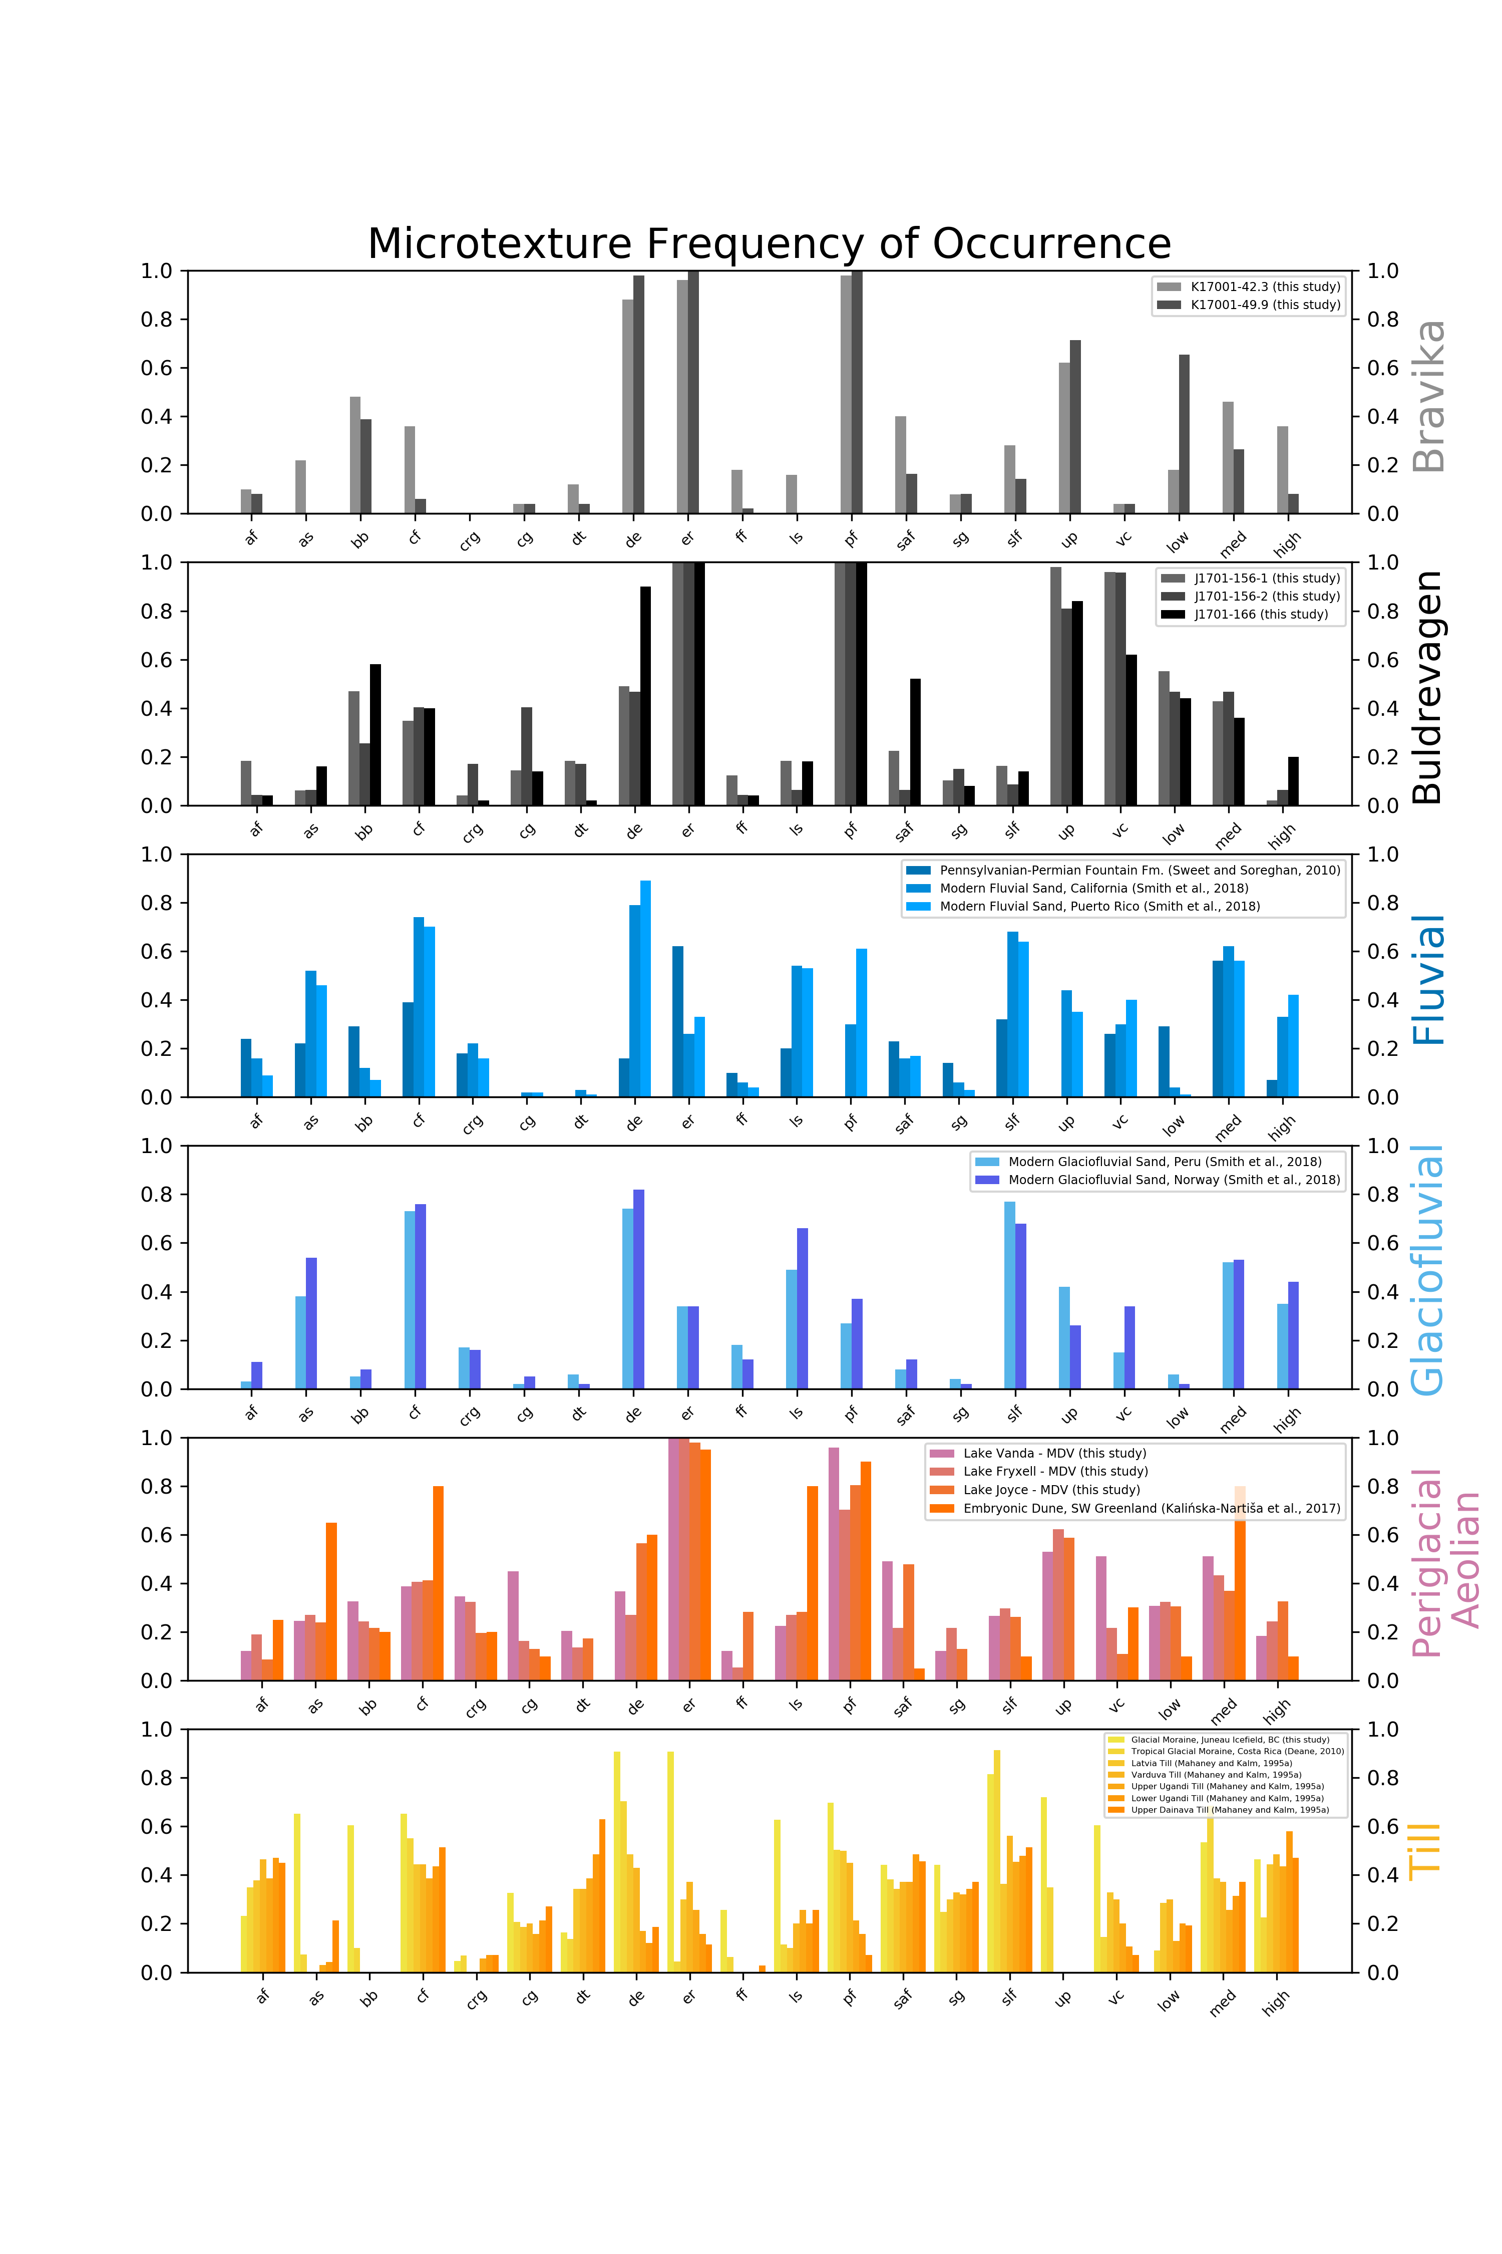
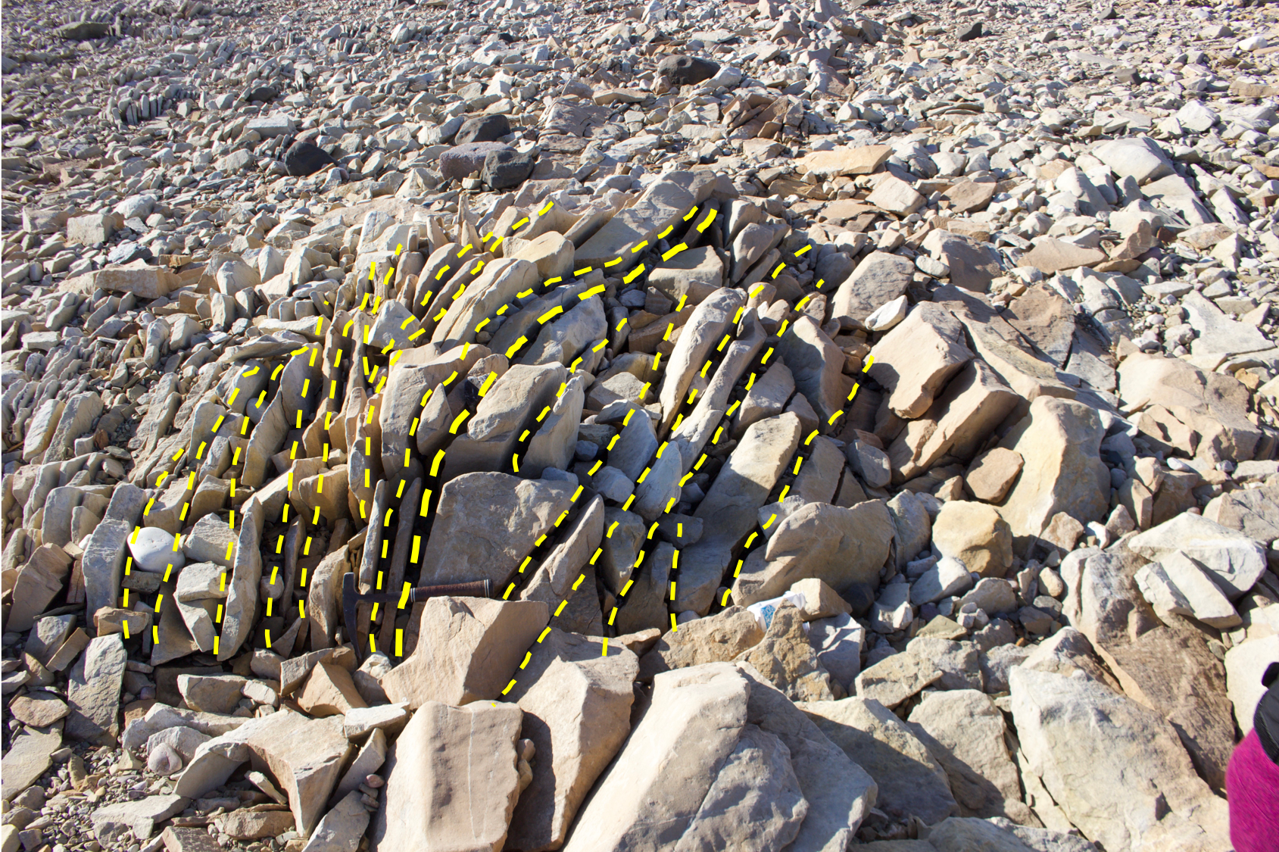
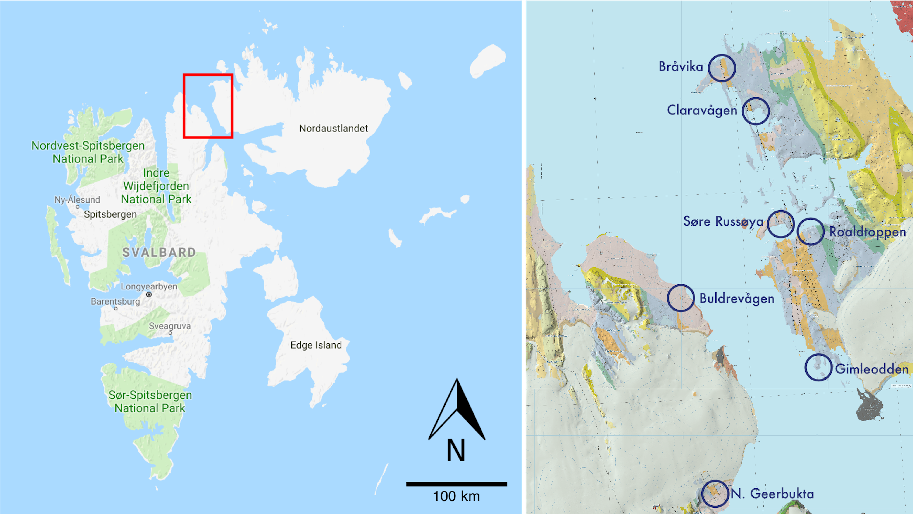
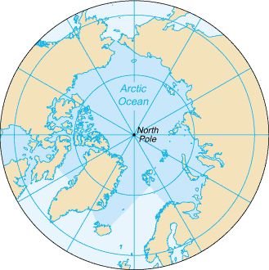
Linking Sedimentary Textures to Neoproterozoic Climate Dynamics Jocelyn N. Reahl, Marjorie D. Cantine, Julia Wilcots, Tyler J. Mackey, Kristin D. Bergmann
The Bråvika Member: An Identity Crisis
We used scanning electron microscopy (SEM) to constrain the depositional environment and paleoclimate of the Neoproterozoic Bråvika Member in Northeastern Svalbard. We find that the Bråvika represents a periglacial aeolian facies, which agrees with field observations in Svalbard and implies synchronous, subaerial deposition with the Marinoan “Snowball Earth” glaciation.
Scanning Electron Microscopy (SEM)
The Bråvika Member (Halverson et al., 2004) is a Cryogenian (720 – 630 Ma), paleo-equatorial wedge of sandstones and dolomites (Figure 1; Hoffman et al., 2012) in NE Svalbard, Norway.
Sits at the boundary between two vastly different climate states: an older, nonglacial tropical equatorial climate (Elbobreen Fm.) and a younger, glacial Snowball Earth state (Wilsonbreen Fm.)
The surface textures of siliciclastic grains, or microtextures, record the transport history and depositional environment of sedimentary grains.
Scanning electron microscopy (SEM) can help constrain depositional environments, and potentially lend insight into the climate during deposition (Smith et al., 2018).
Non-Metric Multidimensional Scaling (NMDS) Analysis
Methods
Sorted into 125 µm – 1 mm size range.
Treated with 30% hydrogen peroxide solution – remove organics.
Treated with 1N hydrogen chloride solution – remove carbonate.
Treated with citrate-bicarbonate-dithionite (CBD) method (Janitsky, 1986) – remove iron and magnesium oxides.
Randomly selected 50 grains per sample and arranged onto sample stub in 5x10 grid (Figure 7).
Analyzed quartz grains in the blind manner of Smith et al. (2018) for the presence (1) or absence (0) of 20 microtextures (Table 1).
Figure 1. Composite stratigraphic column of the Polarisbreen Group of NE Svalbard (Hoffman et al., 2012).
Glaciofluvial
(Halverson et al., 2004)
Herbert Glacier terminus,
Juneau, Alaska, USA
(PC: Jocelyn Reahl)
What depositional environment does the Bråvika represent?
Aeolian
Glacial/Nonglacial
(Halverson, 2011)
Windblown periglacial sand,
McMurdo Dry Valleys,
Antarctica
(PC: Tyler Mackey)
Table 1. Microtexture names and abbreviations
Figure 7. SEM stub with 50 arranged grains
Interpretations
What does that imply for Neoproterozoic climate states?
NMDS analysis indicates that Bråvika and Buldrevågen samples are most closely related to periglacial aeolian facies.
Agrees with recent field observations of the Bråvika Mbr. (Figure 8) that indicate synchronous deposition during the Marinoan “Snowball Earth” glaciation.
Provides evidence for subaerial exposure of landmasses during at least one Cryogenian glaciation ➔ implications for “snowball” vs. “slushball” models of Neoproterozoic panglaciations.
Tropical Fluvial
(Hoffman et al., 2012)
Tapajós River, Brazil
(PC: Morgan Schmidt)
Figure 6. NMDS ordination of all samples. The length (magnitude) of the arrows indicate the strength of the correlation coefficient between the microtextures (variables) and the scores of the samples. The proximity of samples to each other indicates their degree of similarity. Samples opposite of each other (~180°) are the most dissimilar.
Results – Photos and Frequency of Occurrence
Figure 2. Proposed endmember environments for the Bråvika.
(A)
(B)
(C)
(A)
(B)
(D)
(E)
(F)
Figure 8. Field photos of the Bråvika Mbr. at Buldrevågen. A.) Boulders with a clast of the Wilsonbreen Fm. (circled in yellow) and with ice-cemented clasts (dark orange, outlined in white). B.) Trough cross-stratification in Buldrevågen (outlined in yellow).
Acknowledgements
References
(G)
(H)
(I)
This work was performed in part at the Harvard Center for Nanoscale Systems (CNS), a member of the National Nanotechnology Coordinated Infrastructure Network (NNCI), which is supported by the National Science Foundation under NSF award no. 1541959. Many thanks to Tim Cavanaugh at Harvard CNS for his SEM assistance. Samples and field photos from the Juneau Icefield were collected during the 2019 field season of the Juneau Icefield Research Program (JIRP); many thanks to Dr. Seth Campbell, Annie Boucher, Newt Krumdieck, Dr. Ibai Rico, the field staff, and Coastal Helicopters for managing logistics on the expedition. Finally, special thanks go to the members of the Bergmann Lab in the Department of Earth, Atmospheric, and Planetary Sciences at MIT for financial and academic support of this work.
Deane, S. M. (2010). Quartz grain microtextures and sediment provenance: Using scanning electron
microscopy to characterize tropical highland sediments from Costa Rica and the Dominican Republic. (Master of Science), University of Tennessee – Knoxville, Knoxville, Tennessee. (618)
Halverson, G. P. (2011). Glacial sediments and associated strata of the Polarisbreen Group,
northeastern Svalbard. In E. Arnaud, Halverson, G.P. (Eds.), The Geological Record of Neoproterozoic Glaciations (Vol. 36, pp. 571-579). London, United Kingdom: Geological Society.
Halverson, G. P., Maloof, A.C., Hoffman, P.F. (2004). The Marinoan glaciation (Neoproterozoic) in
northeast Svalbard. Basin Research, 16, 297-324.
Hoffman, P. F., Halverson, G.P., Domack, E.W., Maloof, A.C., Swanson-Hysell, N.L., Cox, G.M. (2012).
Cryogenian glaciations on the southern tropical paleomargin of Laurentia (Northeastern Svalbard and East Greenland), and a primary origin for the upper Russøya (Islay) carbon isotope excursion. Precambrian Research, 206-207, 137-158.
Janitsky, P. (1986). Laboratory methods: citrate-bicarbonate-dithionite (CBD) extractable iron and
aluminum. In: Singer, M.J., Janitsky, P. (eds.), Field and laboratory procedures used in a soil chronosequence study, vol. 1648, pp. 38-41. U.S. Geological Survey Bulletin.
Kalińska-Nartiša, E., Lamsters, K., Karušs, J., Krievāns, M., Reč, A., Meija, R. (2017). Quartz grain
features in modern glacial and proglacial environments: A microscopic study from the Russell Glacier, southwest Greenland. Polish Polar Research, 38 (3), 265-289.
Mahaney, W. C., Kalm, V. (1995). Scanning electron microscopy of Pleistocene tills in Estonia. Boreas,
24, 13-29.
Smith, C., Soreghan, G.S., Ohta, T. (2018). Scanning electron microscope (SEM) microtextural analysis
as a paleoclimate tool for fluvial deposits: A modern test. Geological Society of America Bulletin, 130 (7-8), 1256-1272.
Sweet, D. E., Soreghan, G.S. (2010). Application of quartz sand microtextural analysis to infer cold-
climate weathering for the equatorial Fountain Formation (Pennsylvanian-Permian, Colorado, U.S.A.). Journal of Sedimentary Research, 80, 666-677.
100 km
Figure 5. Collage of representative SEM photomicrographs for each sample characterized for the first time in this study. A.) Bråvika Mbr. – Bråvika (BR) Sample 1; B.) Bråvika Mbr. – BR Sample 2; C.) Bråvika Mbr. – Buldrevågen (BU) Sample 1; D.) Bråvika Mbr. – BU Sample 2; E.) Bråvika Mbr. – BU Sample 3; F.) Lake Vanda, McMurdo Dry Valleys (MDV); G.) Lake Fryxell, MDV; H.) Lake Joyce, MDV; I.) Unconsolidated Till Moraine, Juneau Icefield, BC
Figure 3. A.) Map of Svalbard, Norway. Inset is a north polar map, where the red box in the inset highlights the Svalbard archipelago. Large red box in A.) outlines B.) a geologic map of Northeastern Svalbard and Western Nordaustlandet. Samples for this study were collected in Bråvika and Buldrevågen.
Figure 4. Frequency of occurrence plots for all samples used in this study. Plots are grouped by facies.

